Slide 1



DSCI 6004: NATURAL LANGUAGE PROCESSING
AUTOMATED RESUME SCREENING FOR HIRING TEAMS USING RETRIEVAL-AUGMENTED GENERATION (RAG)
Team members:
Pavan kumar sunkara
Veda prakash chiliveru

Slide 2
Project topic and domain
Topic: Automated Resume Screening using Retrieval-Augmented Generation(RAG)
Domain: Human Resources, Recruitment Automation
Corpus: Resume databases, job descriptions

Slide 3
Statement of objectives
Implement a RAG system to automate resume screening and candidate-job matching
Compare the performance of three open-source LLMs
Evaluate accuracy, retrieval efficiency, and generative quality across models

Slide 4
Statement of value
Efficiency: Reduces manual effort in resume screening
Accuracy: Improves candidate-job matching
Insights: Provides AI-generated resume summaries and kill gap analysis
Decision Support: Helps recruiters to rank candidates effectively

Slide 5
Statement of the art in rag systems
Overview of RAG models and their impact on HR tech
Recent advancements in open-source LLMs for recruitment automation
Enabling precise resume retrieval, context-aware candidate evaluation, and intelligent job fit analysis for automated hiring processes.

Slide 6
Statement of the art in rag systems (Related works & citations)
Lewis et al. (2020) – Retrieval-Augmented Generation for Knowledge-Intensive NLP Tasks Introduced the RAG architecture combining dense retrieval (DPR) with seq2seq generation.
Citation: Lewis, P., Perez, E., Piktus, A., et al. (2020). RAG: Retrieval-Augmented Generation.arXiv:2005.11401
Reimers & Gurevych (2019) – Sentence-BERT: Sentence Embeddings using Siamese BERT-Networks Created sentence transformers for efficient semantic search, widely used in modern retrieval systems.
Citation: Reimers, N., & Gurevych, I. (2019). Sentence-BERT. arXiv:1908.10084
Kumar et al. (2021) – NLP for Resume Parsing and Matching in Recruitment Explores applying transformers for resume screening and job description matching.
Citation: Kumar, A., & Ramesh, D. (2021). NLP-based Approaches for Automated Resume Screening. Journal of AI Research in HR.

Slide 7
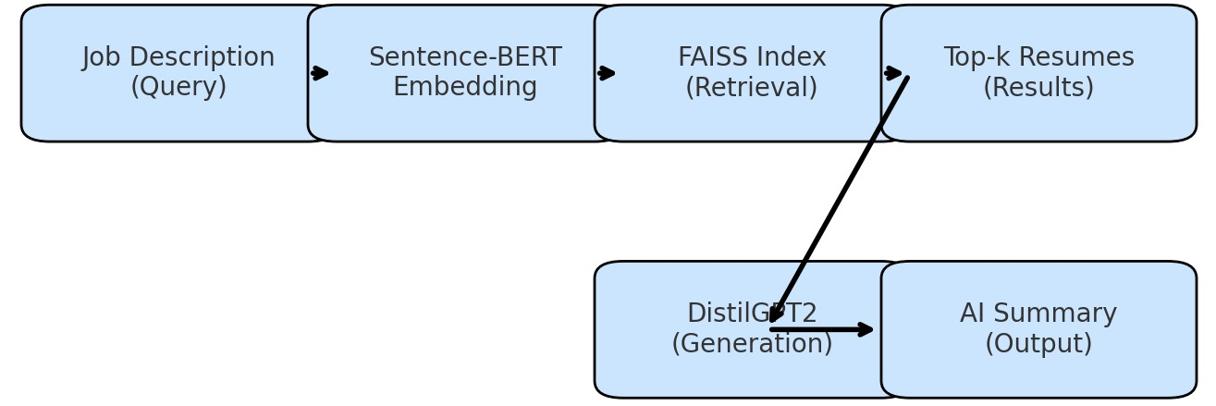
APPROACH
LLMs: Mistral-7B, Llama-3, Phi-3
Knowledge Base: Resume databases, job descriptions, skill taxonomies
System Features(using FAISS and sentence-BERT):
Keyword-based Retrieval: Matches resumes with job descriptions
Skill Gap Analysis: Highlights missing qualifications
AI-generated Resume Summary: Shortlists candidates with AI insights
Candidate Ranking System: Scores candidates based on relevance
System Architecture: Retrieval pipeline, embedding-based search, response generation

Slide 8
DELIVERABLES
Resume & Job Description Embedding System(stores vectors in FAISS vector index for fast retrieval)
RAG-Based Resume Matching(dense semantic search)
AI-Generated Resume Summary
Skill Gap Analysis Module
Candidate Ranking System
Model Benchmarking(Mistral-7B, LLaMA-3, Phi-3)

Slide 9

Evaluation methodology
Retrieval Metrics: Cosine similarity, Top-K ranking
Generation Quality: Coherence, relevance, overage
User feedback, Output- ranked list with AI-generated candidate summary

Slide 10

THANK YOU

